Slide 1
Chapter Four
Managing Marketing Information to Gain Customer Insights

Slide 2
Learning Objectives
Topic Outline
Marketing Information and Customer Insights
Assessing Marketing Information Needs
Developing Marketing Information
Marketing Research
Analyzing Marketing Information
Distributing and Using Marketing Information
Other Marketing Information Considerations

Slide 3
Marketing Information and Customer Insights
Customer Insights
Fresh and deep insights into customers’ needs and wants
Difficult to obtain
  Not obvious
  Customers unsure of their behavior
Not derived from more information but better information and more effective use of existing information

Slide 4
Marketing Information and Customer Insights
Customer Insights
Companies are forming customer insights teams
  Include all company functional areas
  Use insights to create more value for their customers

Slide 5
Marketing Information and Customer Insights
Marketing Information Systems (MIS)
Marketing information system (MIS) consists of people and procedures for:
  Assessing informational needs
  Developing needed information
  Helping decision makers use the information to generate customer insights

Slide 6
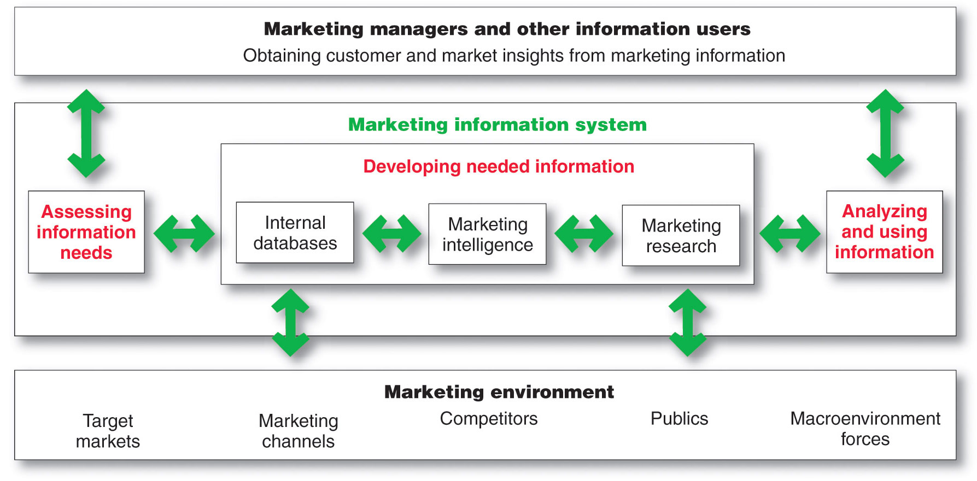
Marketing Information System

Slide 7
Assessing Marketing Information Needs
MIS provides information to the company’s marketing and other managers and external partners such as suppliers, resellers, and marketing service agencies

Slide 8
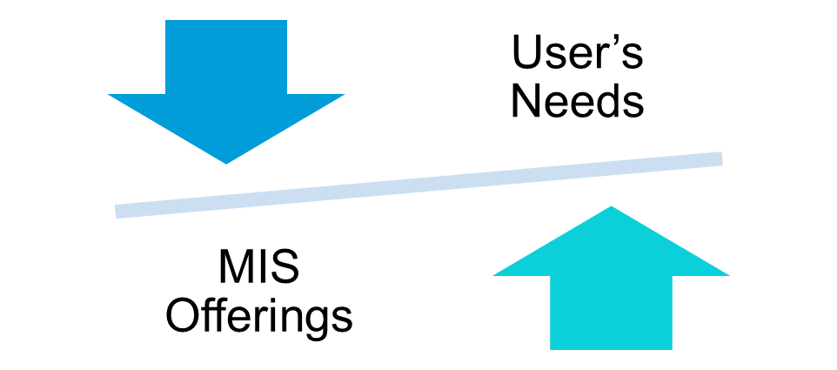
Assessing Marketing Information Needs
Characteristics of a Good MIS
Balancing what the information users would like to have against what they need and what is feasible to offer

Slide 9
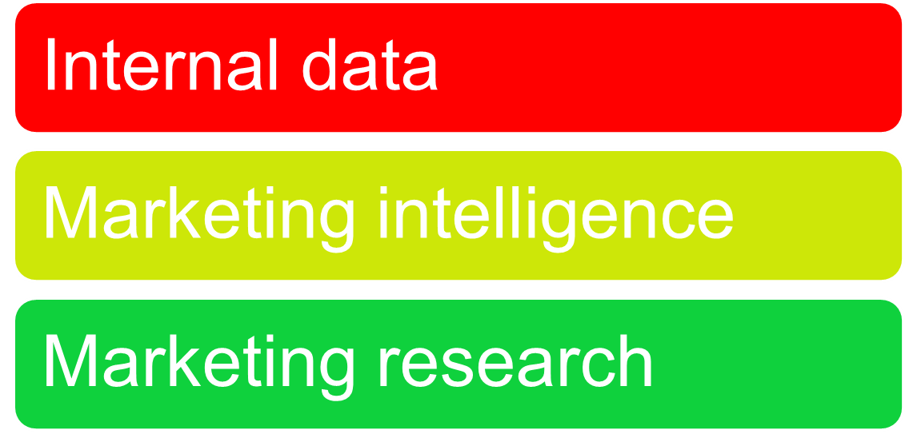
Developing Marketing Information
Marketers obtain information from

Slide 10
Developing Marketing Information
Internal Data
Internal databases are electronic collections of consumer and market information obtained from data sources within the company network

Slide 11
Developing Marketing Information
Marketing Intelligence
Marketing intelligence is the systematic collection and analysis of publicly available information about consumers, competitors, and developments in the marketplace

Slide 12
Developing Marketing Information
Marketing Research
Marketing research is the systematic design, collection, analysis, and reporting of data relevant to a specific marketing situation facing an organization

Slide 13
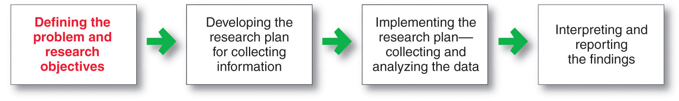
Developing Marketing Information
Steps in the Marketing Research Process

Slide 14
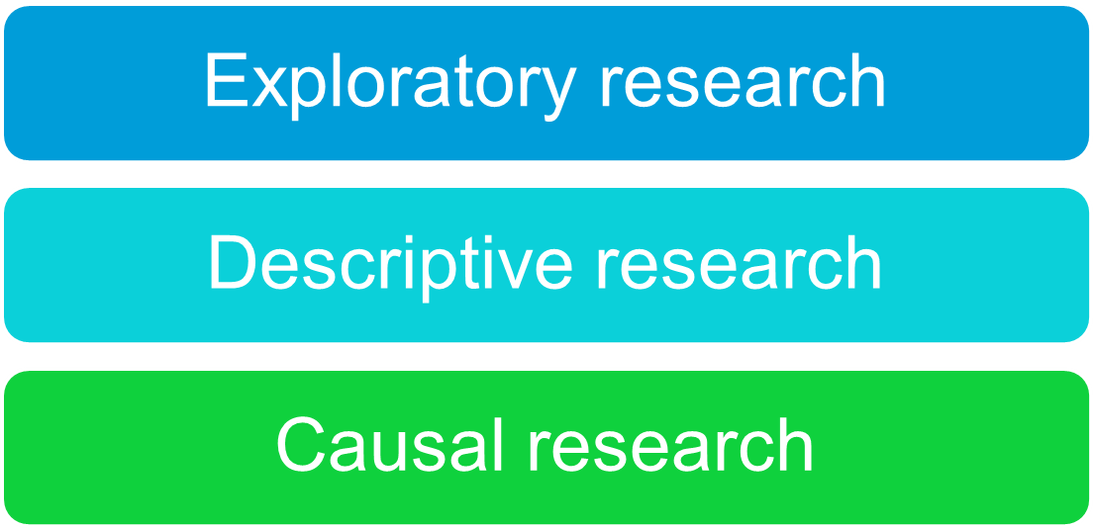
Developing Marketing Information
Marketing Research
Defining the Problem and Research Objectives

Slide 15
Developing Marketing Information
Marketing Research
Developing the Research Plan
Outlines sources of existing data
Spells out the specific research approaches, contact methods, sampling plans, and instruments to gather data

Slide 16
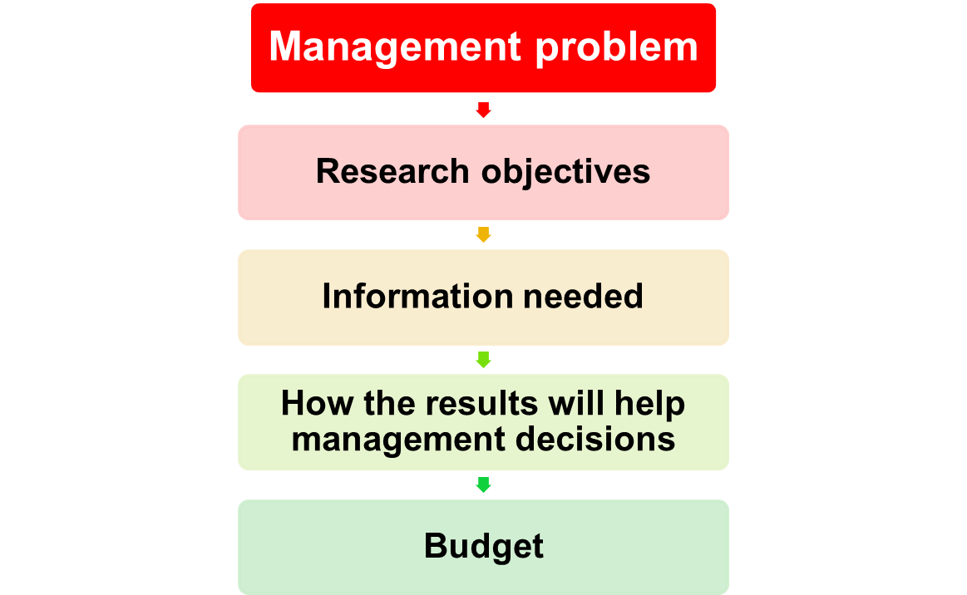
Developing Marketing Information
Marketing Research
Written Research Plan Includes:

Slide 17
Developing Marketing Information
Marketing Research
Developing the Research Plan
Secondary data consists of information that already exists somewhere, having been collected for another purpose
Primary data consists of information gathered for the special research plan

Slide 18
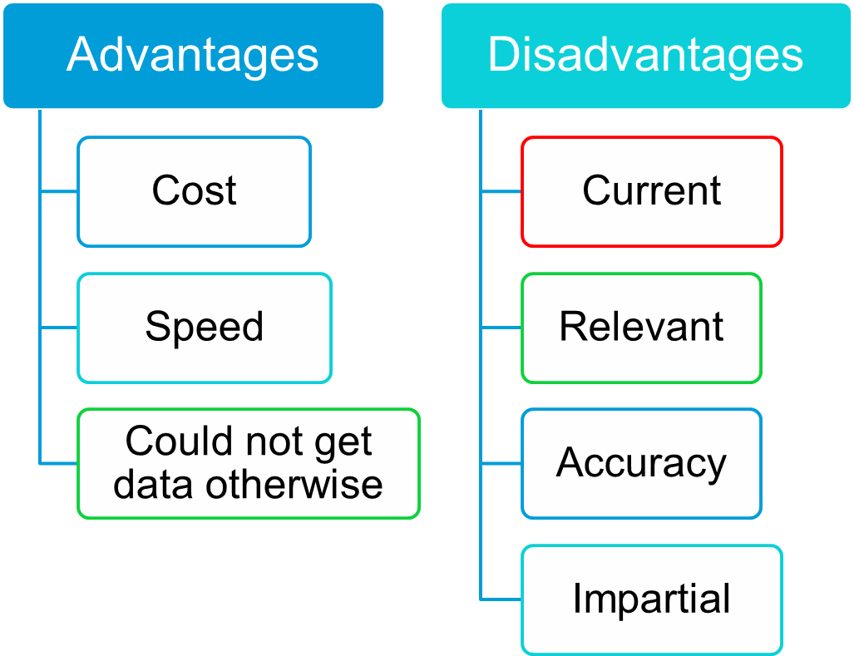
Developing Marketing Information

Slide 19
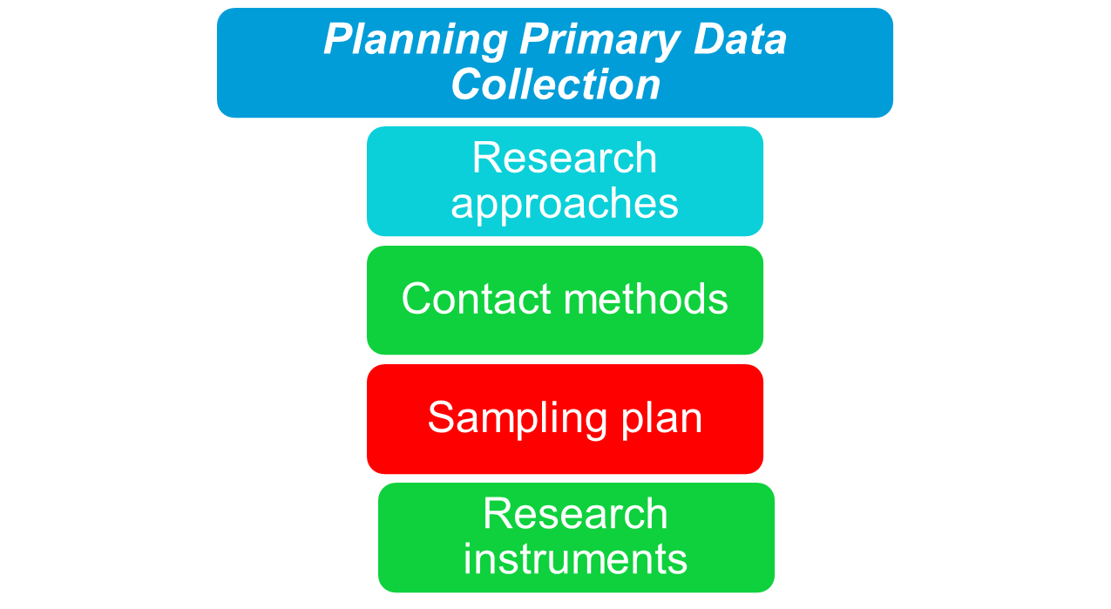
Developing Marketing Information
Marketing Research

Slide 20
Developing Marketing Information
Market Research
Research Approaches
Observational research involves gathering primary data by observing relevant people, actions, and situations
Ethnographic research involves sending trained observers to watch and interact with consumers in their natural environment

Slide 21
Developing Marketing Information
Market Research
Research Approaches
Survey research is the most widely used method and is best for descriptive information—knowledge, attitudes, preferences, and buying behavior
Flexible
People can be unable or unwilling to answer
People may give misleading or pleasing answers
Privacy concerns

Slide 22
Developing Marketing Information
Market Research
Research Approaches
Experimental research is best for gathering causal information—cause-and-effect relationships

Slide 23
Developing Marketing Information
Marketing Research Strengths and
Weakness of Contact Methods
 | Mail | Telephone | Personal | Online
Flexibility | Poor | Good | Excellent | Good
Quantity of data collected | Good | Fair | Excellent | Good
Control of interviewer effects | Excellent | Fair | Poor | Fair
Control of sample | Fair | Excellent | Good | Excellent
Speed of data collection | Poor | Excellent | Good | Excellent
Response rate | Poor | Poor | Good | Good
Cost | Good | Fair | Poor | Excellent

Slide 24
Developing Marketing Information
Marketing Research
Contact Methods
Focus Groups
  Six to 10 people with a trained moderator
  Challenges
    Expensive
    Difficult to generalize from small group
    Consumers not always open and honest

Slide 25
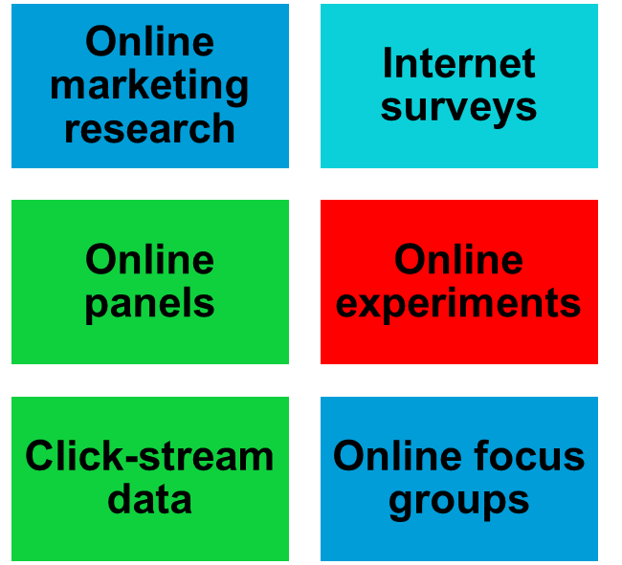
Developing Marketing Information
Marketing Research
Contact Methods

Slide 26
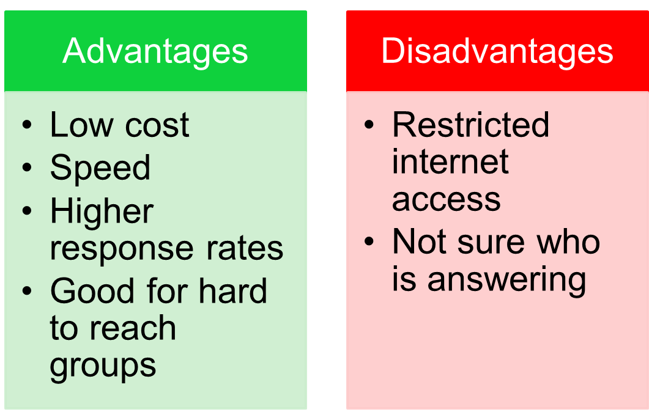
Developing Marketing Information
Marketing Research
Online Research

Slide 27
Developing Marketing Information
Marketing Research
Sampling Plan
Sample is a segment of the population selected for marketing research to represent the population as a whole
  Who is to be surveyed?
  How many people should be surveyed?
  How should the people be chosen?

Slide 28
Developing Marketing Information
Marketing Research
Sampling Plan—Types of Samples
Probability Sample
Simple random sample | Every member of the population has a known and equal chance of selection
Stratified random sample | The population is divided into mutually exclusive groups and random samples are drawn from each group
Cluster (area) sample | The population is divided into mutually exclusive groups and the researcher draws a sample
Nonprobability Sample
Convenience sample | The researcher selects the easiest population members
Judgment sample | The researcher uses his/her judgment to select population members
Quota sample | The researcher finds and interviews a prescribed number of people in each of several categories

Slide 29
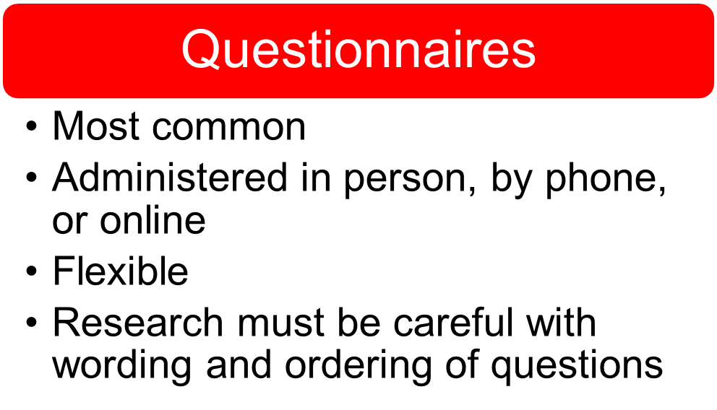
Developing Marketing Information
Marketing Research
Research Instruments

Slide 30
Developing Marketing Information
Marketing Research
Research Instruments—Questionnaires
Closed-end questions include all possible answers, and subjects make choices among them
  Provide answers that are easier to interpret and tabulate
Open-end questions allow respondents to answer in their own words
  Useful in exploratory research

Slide 31
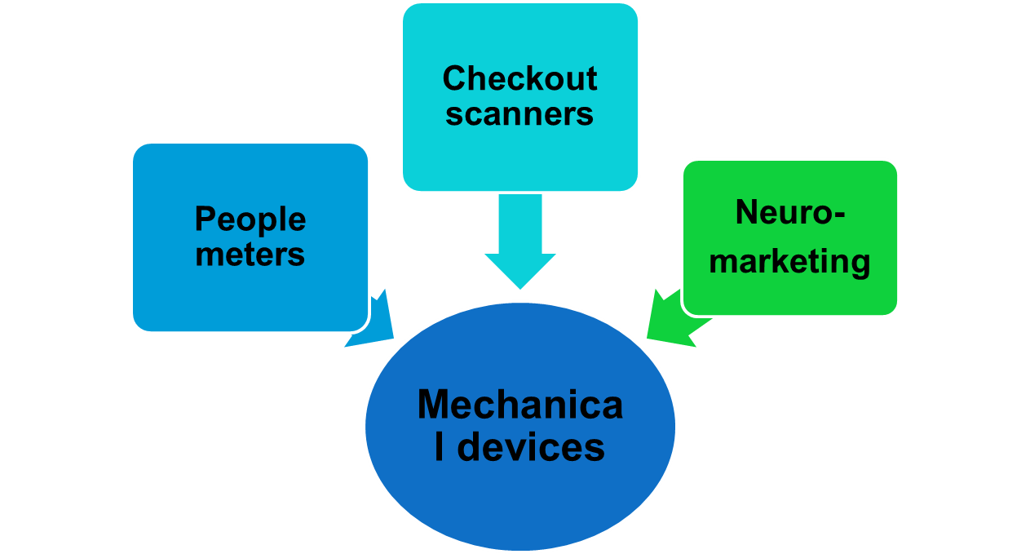
Developing Marketing Information
Marketing Research
Research Instruments

Slide 32
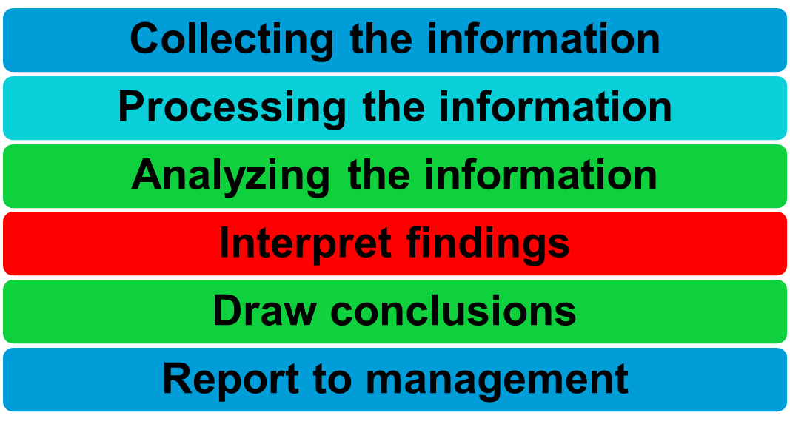
Developing Marketing Information
Marketing Research
Implementing the Research Plan

Slide 33
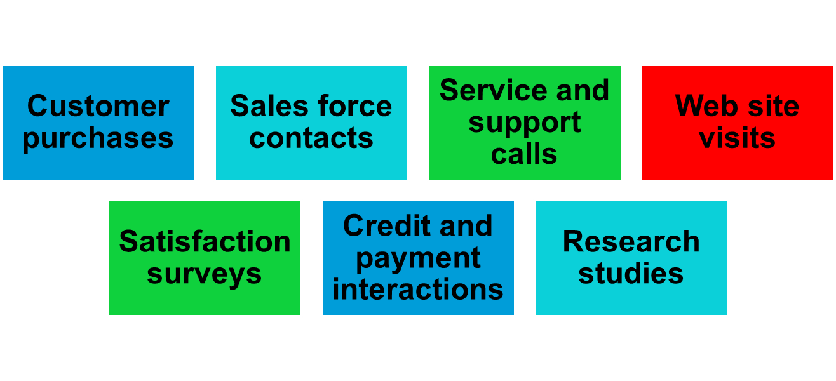
Analyzing and Using Marketing Information
Customer Relationship Management
Touchpoints

Slide 34
Distributing and Using Marketing Information
Information distribution involves entering information into databases and making it available in a time-usable manner
Intranet provides information to employees and other stakeholders
Extranet provides information to key customers and suppliers

Slide 35
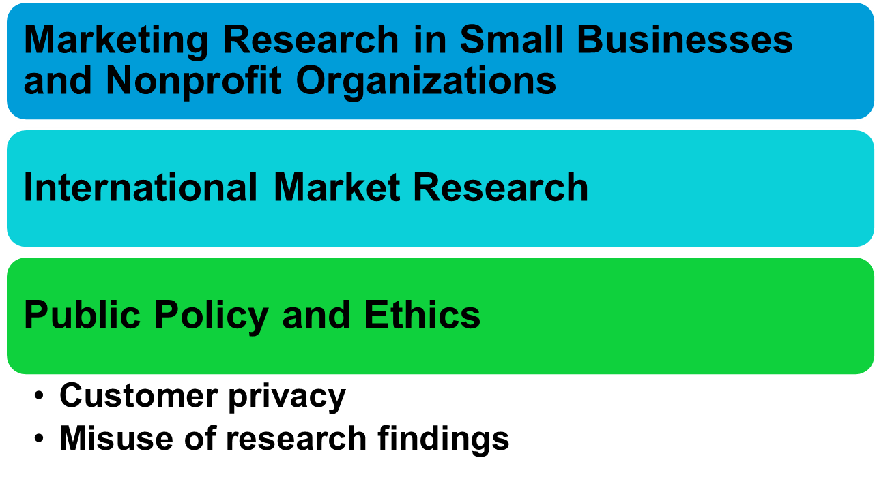
Other Marketing Information Considerations

Slide 36

All rights reserved. No part of this publication may be reproduced, stored in a retrieval system, or transmitted, in any form or by any means, electronic, mechanical, photocopying, recording, or otherwise, without the prior written permission of the publisher. Printed in the United States of America.
Copyright © 2010 Pearson Education, Inc.
Publishing as Prentice Hall

